Slide 1
Sean Koppenhafer, Jaime Rodriguez,
Chad Thueson, Noah Erickson, Rishal Dass
Weekly meeting, 4/8/2015
Digital Dash
Portland State University
Department of Electrical and Computer Engineering (ECE)
Notes:
1
1

Slide 2
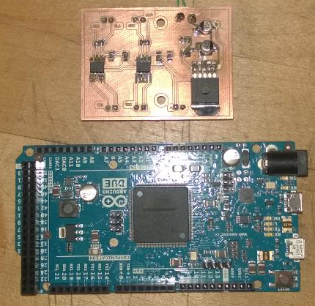
Prototype boards
Boards to be used in prototype enclosure
Power Board steps 12V down to 5V also includes CAN transceiver circuitry
Arduino Due interprets data from CAN lines and passes data to the display
Production board will be same size as due and will contain the power supply CAN transceiver circuitry

Slide 3
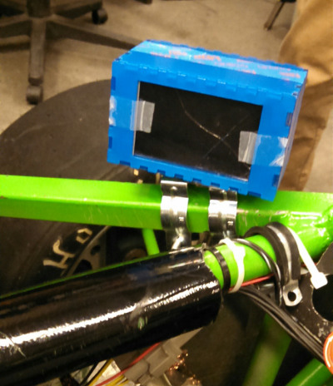
Enclosure
Simple enclosure created for track day testing
Mounted to side of driver pod to eliminate driver blindspot
Track day enclosure is also water resistant
Final Position of Display determined by Motor Sport Group
Present location to integrated into dash directly behind steering wheel
Ideal location would be recessed under cowling behind steering wheel

Slide 4
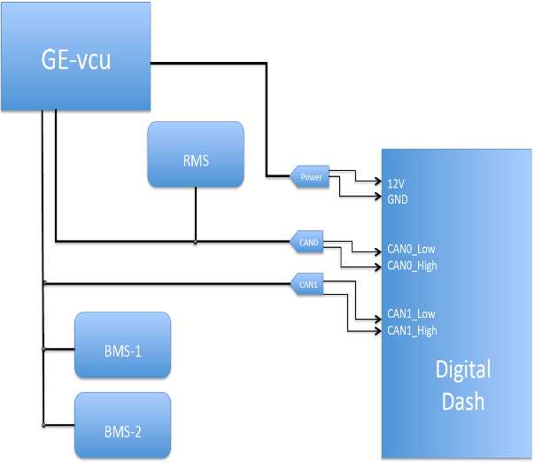
Wiring diagram
Required wires that VMS needs to provide access to for final implementation of Digital Dash
Ideally all wires are contained in a single bundle and connector

Slide 5
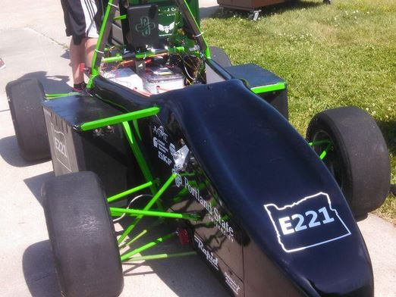
Electric Vehicle Update
In Progress
Chassis still needs to be completed
Systems to be transferred to new chassis over next couple of weeks (no hard timeline)
Vehicle must be complete in 30 days or not eligible to race this season
BMS still not cooperating

Slide 6
Goals For The Upcoming Week
System
- Continue troubleshooting BMS system.
- Add additional RMS error codes to be displayed.
Enclosure
- Run wires from vehicle to enclosure.
- Vibration testing to ensure display doesn’t come loose during track day testing
- Continue dialog with VMS about display location
Documentation
- Information and layout cleaned up on Wiki
- Update report
Notes:
6

